Slide 1

Cleveland Airport System
Environmental Analytical and Regulatory Services
Pre-Qualification Meeting
November 3, 2023

Slide 2

Pre-Qualification Meeting Agenda
Introduction……………………………………………... Kim McGreal
Project General Scope…………….…………………… Michael Reilly
Safety ………………………………….……………….... Alyssa Biondo
Security …………………………………………………… Jeff Allhouse
Operations ……………………………………………….. Zachary Randall
DBE Requirements …………………………….…….... Rosita Turner
Questions and Answers
Please send all future questions to:
Sharri Muia
SMuia@clevelandairport.com

Slide 3
Introduction
The City of Cleveland, Department of Port Control is responsible for the planning, operation, and development of CLE and BKL.
Our goal is to ensure that we meet the needs of the present without compromising our ability to meet the needs of the future.
We aim to achieve this through continued customer and stakeholder satisfaction as well as flexible development ushered in through comprehensive planning.

Slide 4
Ordinance
Ordinance No. 692-2021

Slide 5
Project Overview
On an on-call basis, the Selected Consultant shall:
  Be required to provide regulatory reporting services including consultation and report generation as required by applicable law and regulatory agency (e.g., USEPA, Ohio EPA, etc.);
  Provide the necessary equipment, facilities, utilities, labor, supervision, management, administration, technical support and consumables, as needed, to facilitate the work without delay of normal airport operations and completion of the work in a timely fashion; and
  Comply with all necessary reporting timeframes throughout the duration of the contract period.
These services include a mix of anticipated and unanticipated tasks.

Slide 6
Scope of Services
Laboratory Services
  Full service, independent, environmental laboratory must be licensed and appropriately certified in the State of Ohio as of the date of the issuance of this RFQ and maintained throughout the contract period.
  Shall provide shipping containers and coolers, sample containers, preservative, and shipping. All items must meet standard EPA protocols.
  Shall coordinate with DPC and its Consultants for project requirements and timely delivery of supplies.
  Shall provide guidance to DPC and its Consultants with applicable method numbers, sample container requirements, collection methods, preservatives, handling methods, and shipping requirements - all conforming to EPA methods. The laboratory shall also secure subcontracted services when a service can not be fulfilled by the laboratory.
  Shall retain and dispose of all unused sample volumes, test blanks, and associated media
  Will provide analytical reports in a timely manner with all pertinent information and copy of chain-of-custody (COC).

Slide 7
Scope of Services (cont’d)
National Pollutant Discharge Elimination System (NPDES):
  The selected consultant may assist in the following tasks:
    Permit compliance, permit renewal, SWP3 and SPCC updates, compliance strategy development, regulatory agency coordination, monthly reporting, sample collection, source identification and investigations, trend and data analysis, etc.
Biofilm and Treatability Project
  The Successful Consultant will be required to continue these projects through semiannual sample collection and reporting, treatment strategies, siting restrictions, etc., implementation timeline development and updating, and if necessary, designing a treatment facility to achieve the goal of reducing biofilms and COD in receiving waters.
Notes:
Cleveland Hopkins International Airport (CLE) operates with an individual NPDES permit 3II00179 and Burke Lakefront Airport (BKL) operates with the General Permit OHR000007 (and subsequent permits).
As part of its NPDES permit, CLE is working towards reducing biofilms in receiving waters associated with winter deicer usage. Previous work has identified the primary constituents of the biofilm assemblage and indicator parameters of nuisance growths. Current initiatives include identifying methods for reducing Chemical Oxygen Demand (COD) through scalable passive and active treatment approaches.

Slide 8
Scope of Services (cont’d)
Air Permitting
  The selected consultant may be utilized to assist with calculations, audits, regulatory inquiries, construction projects, strategy development, grants, etc.
Sustainability
  The Department may create a Sustainable Master Plan that is integrated into the Airport Master Plan. Assistance in these tasks may be needed.
Purchases
  Typical purchases may include ISCO stormwater sampling equipment, YSI water quality meters, field supplies, spill supplies (booms, granular, pads, etc), tools, consumables (batteries, gloves, calibration solutions, sampler tubing, etc).
Notes:
CLE operates with a Synthetic Minor Air Permit.

Slide 9
Scope of Services (cont’d)
Examples of On-call Services
  Emergency Response assistance – sampling, air monitoring, and spill response.
  Landfill permit generation and review for construction projects and maintenance, input on resolving settling and releases, etc.
  Wetlands delineation, mitigation.
  Mold remediation and air monitoring.
  BUSTR compliance.
  Noise monitoring and maintenance.
  NEORSD credit applications.
  Grant writing, management, and closure.
Recordkeeping and Reporting
  Reports will be required on a task order basis. Reports may be consolidated into a single monthly report at the discretion of the Department.
  Examples of reporting:
    Biofilm study reports
    Treatability reports
    Investigation reports

Slide 10
Tristian A. Hooten, MPA
Airport Health and Safety Manager
City of Cleveland, Department of Port Control
Office: (216) 265-6965 | Cell: (216) 857-6931
email: thooten@clevelandairport.com
Safety
Safety Management System
OSHA/FAA/DPC/Requirements
Site Specific Health and Safety Plan
Insurance requirements

Slide 11
Security
Shawn M Harris, Sr
Interim Security Manager
City of Cleveland, Department of Port Control
Office: (216) 265-3981
email: sharris@clevelandairport.com
The Firm must assume the cost of each Cleveland Hopkins Airport issued access media. The cost is $65 non-refundable for the following:
  Fingerprint based Criminal History Records Check (CHRC)
  Security Threat Assessment (STA)
  Training on Airport specific Security badge responsibilities
  Payment to “Treasurer, City of Cleveland”. Checks, Credit Cards or if authorized by finance it may be invoiced monthly
  Expect 1-3 weeks to complete the process
All vehicles operating outside of the VSR will require an escort. Vehicles operating in the VSR will require an escort if the operator does not have a SIDA badge and driving privileges. Vehicles must be properly marked and lighted. All vehicle movement must comply with the rules and regulations of the FAA and the Airport.
Ramp hang tags to allow vehicle access may be attained provided all qualifications for insurance are met.
  Current registration
  Proper signage (2ft x 2ft company logo)
  $10 million policy
No credentials will be issued until a Notice to Proceed is issued.
Please allow 5-7 days for processing after Fingerprint results are received.

Slide 12
Operations
Zachary Randall
Manager Airport Operations
(216) 265-6791
zrandall@clevelandairport.com
CLE OPERATIONS: (216) 265-6090
Emergency Phone contacts of personnel will be delivered to Airport Operations for contacts regarding project site and its activities
Activity on the airport must comply with the requirements of FAA rules and regulations. Reference the construction Advisory Circular “Operational Safety on Airports During Construction,” 150/5370-2, current version (E). This file may be downloaded from the FAA’s website at http://www.faa.gov
Incursions (unauthorized access into an area intended for the movement of aircraft) will not be dealt with lightly, especially a runway incursion. Any incident will most likely result in the removal of the subject individual, and possibly the supervisor, from the airfield permanently
Site maintenance should be performed on a regular basis to include the sweeping of debris and collection of trash. This is for FOD / dust / wildlife control purposes

Slide 13
Office of Compliance and Inclusion (OCI)
Contact Information
Rosita Turner
Manager
(O)216-265-6606
(M) 216-857-6875
E-mail: rturner@clevelandairport.com

Slide 14

POINTS OF DISCUSSIONS:
FEDERAL program Requirements
(DBE/SBE/ACDBE)
Provisions of the Federal Programs
Project Specific Goals
Statement of Qualifications
SBE Verification and Validation
Required OCI Forms/Documents
Project Compliance Requirements
Fraud and Sanctions
OCI Website and Resources
Notes:
14

Slide 15
1. PROVISIONS OF THE FEDERAL PROGRAMS
1a. 49 CFR PART 26 - DISADVANTAGED BUSINESS ENTERPRISE (DBE)
1b. 49 CFR PART 23 - AIRPORT CONCESSIONS DISADVANTAGED BUSINESS ENTERPRISE (ACDBE)
    1c. Effective March 2013:
    Small Business Enterprise (SBE) as an element of the DBE Program
Notes:
15

Slide 16
2. PROJECT SPECIFIC GOALS
DBE Project Specific Goal __7.66__%
Based on willingness, readiness and availability
Certified DBE/ACDBE website: http://www.dot.state.oh.us/dbe/Pages/UCP.aspx
Small Business Enterprise (SBE) Project Goal: _1.99%
RT/OCI FEDERAL PROGRAMS REQUIREMENTS UPDATED 01.12.2022
Notes:
16

Slide 17
3. STATEMENT OF QUALIFICATION (SOQ)
What to do in RFQ?
Submit
DBE Utilization Plan
Must demonstrate Good Faith Effort in obtaining DBEs
NOTE: No Good Faith Effort will be considered a non-compliance SOQ.
When selected, complete ALL required DBE forms.
Notes:
17

Slide 18
4. SBE VERIFICATION AND VALIDATION
2 Kinds of SBEs
Certified DBEs
Non-certified DBEs Validation
Submission requirements:
  b1. Application to OCI
b2. Most recent three (3) years business tax returns
b4. Copy of certification from one of the following agencies:
b4-1. CSB Certification - Cleveland OEO
b4-2. Small Business Certification - Cuyahoga County
b4-3. US SBA 8(a) Certification
b4-4. NEORSD Certification
b4-5. Northern Ohio Supplier Diversity Council Certification
RT/OCI FEDERAL PROGRAMS REQUIREMENTS UPDATED 01.12.2022
Notes:
18

Slide 19
5. REQUIRED OCI DOCUMENTS
5a. Certified DBEs:
5a1. B-3 (DBE/ACDBE Participation Plan)
5a2. B-2 (DBE/ACDBE Affidavit)
5a3. B-4A (Letter of Intent to Perform as Subcontractor/Sub-consultant)
5b. Good Faith Effort
5c. Non Certified DBEs/SBEs:
5c1. B-6 (Non DBE/SBE/ACDBE Participation Plan)
5c2. B-4B (Letter of Intent to Perform as Subcontractor/Sub-consultant)
RT/OCI FEDERAL PROGRAMS REQUIREMENTS UPDATED 01.12.2022
Notes:
19

Slide 20
5. REQUIRED OCI DOCUMENTS - continuation
5d. Tier Subcontractors (i.e. 2nd/3rd…)
5d1. B-8 (2nd Tier/3rd Tier Subcontractor/Sub-consultant)
5d2. For DBE: B-2 and B-4A; For Non DBE: B-4B
5e. Emergency Utilization of Subcontractors
  5e1. B-9 (Emergency Addition-Conditional Approval of Subcontractor/Sub-
  consultant)
  - limited to 3 requests only
  5E2. Revised DBE/Non-DBE forms whichever is applicable
5f. With ongoing projects, submit:
5f1. Revised DBE/Non-DBE forms
5f2. Copies of ALL sub contracts, sub-agreements and POs
RT/OCI FEDERAL PROGRAMS REQUIREMENTS UPDATED 01.12.2022
Notes:
20

Slide 21
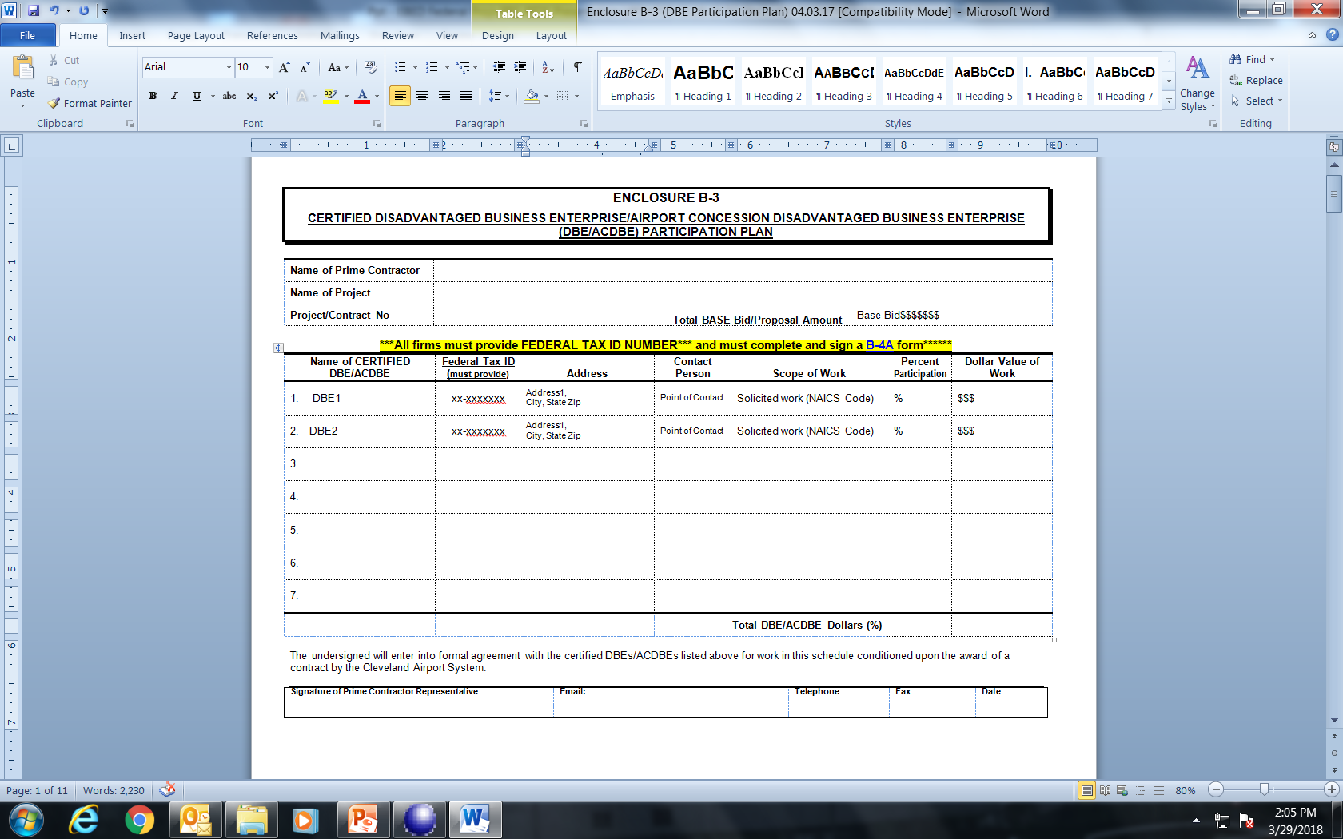
5a1. ENCLOSURE B-3
(DBE Participation Plan)
RT/OCI FEDERAL PROGRAMS REQUIREMENTS UPDATED 01.12.2022
Notes:
21

Slide 22
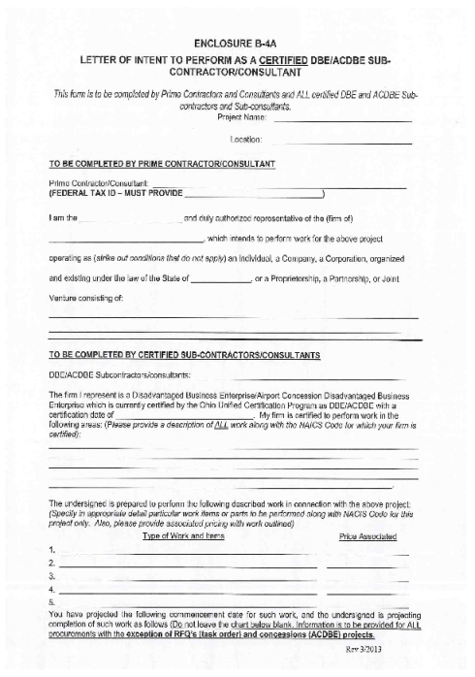

5a2. Enclosure B-2 (DBE AFFIDAVIT)
5a3. Enclosure B-4A (Intent to Perform…)
Enclosure B2
Enclosure B4-A
(Intent to Perform as Certified DBE)
(DBE AFFIDAVIT)
RT/OCI DBE /SBE/ACDBE REQUIREMENTS UPDATED 01.12.2022
Notes:
22

Slide 23
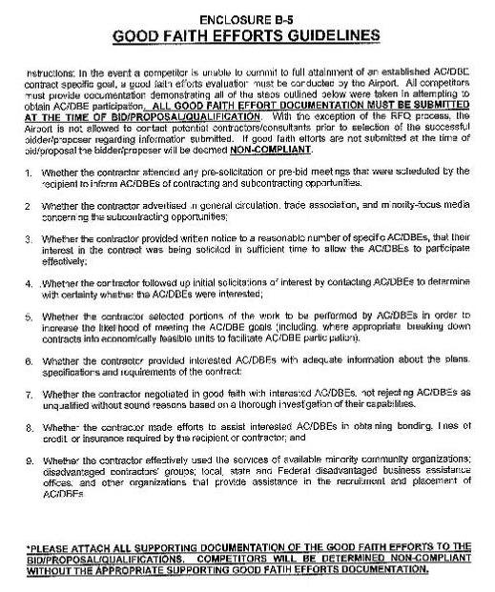
5b. Good Faith Effort
(49 CFR Part 26.53)
All solicitation documentations must be included with proposals upon submissions
[49CFR Part 26-Appendix A49 CFR 26.53(a)(2)]
RT/OCI FEDERAL PROGRAMS REQUIREMENTS UPDATED 01.12.2022
Notes:
23

Slide 24
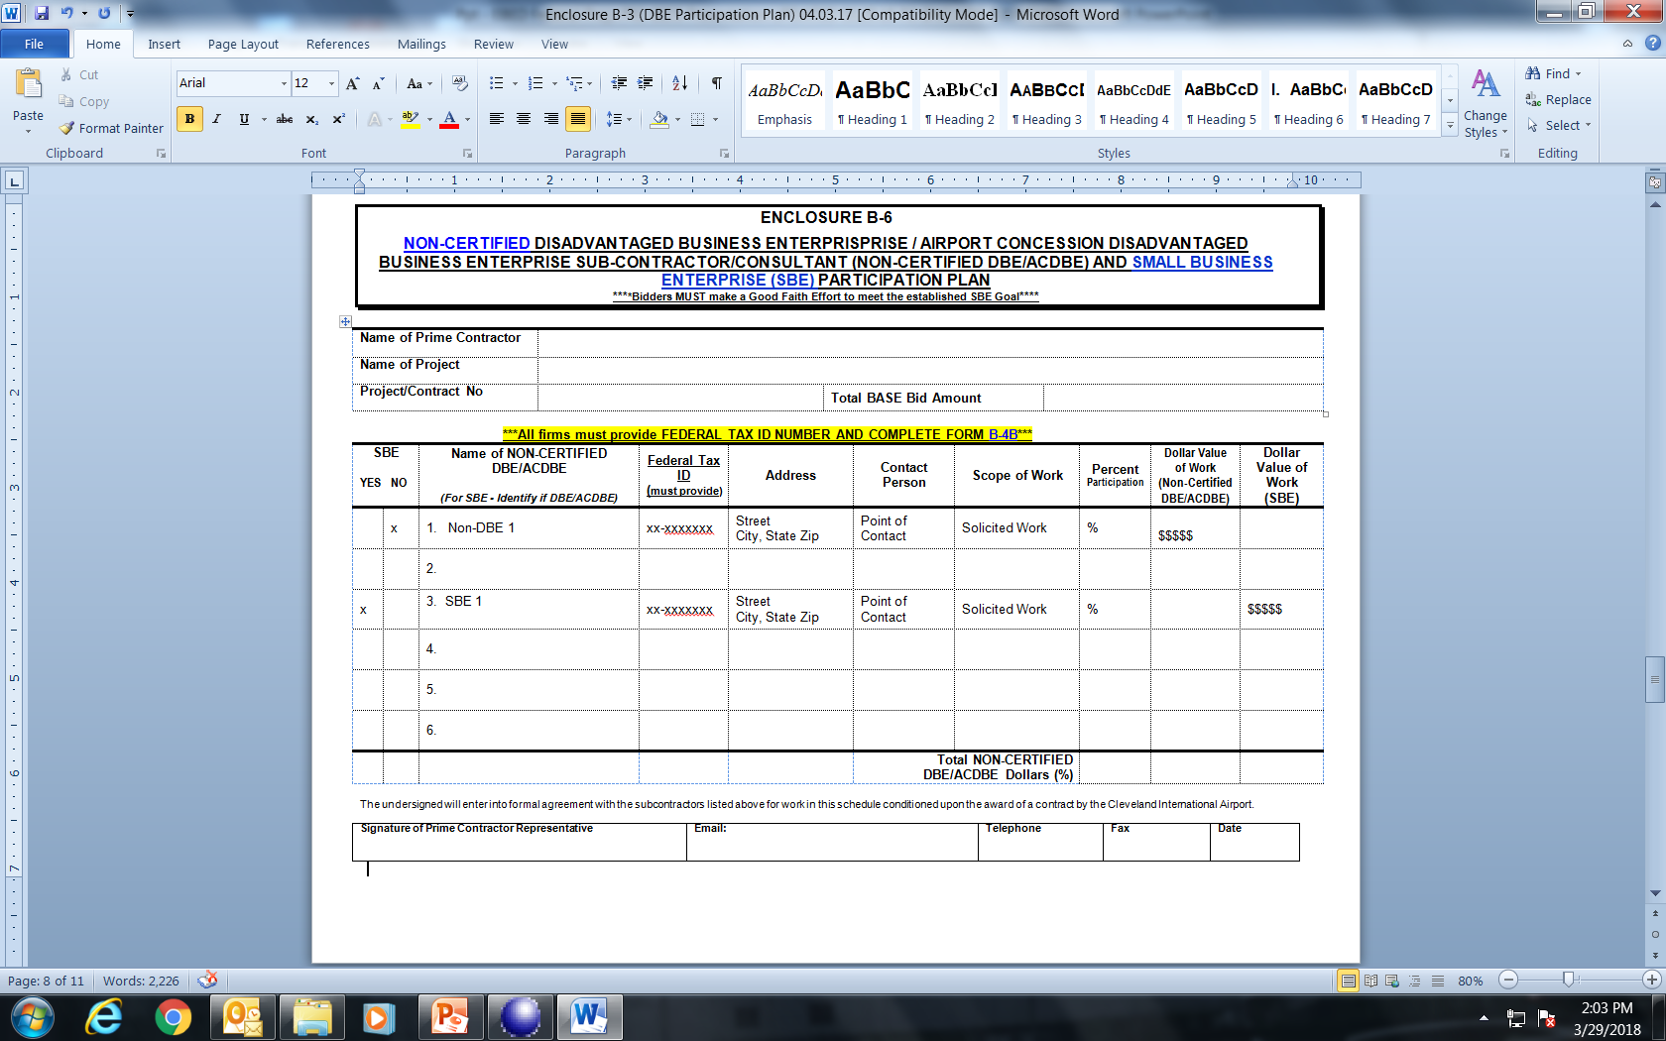
5c1. ENCLOSURE B-6
(NON CERTIFIED DBE/SBE PARTICIPATION PLAN)
RT/OCI FEDERAL PROGRAMS REQUIREMENTS UPDATED 01.12.2022
Notes:
24

Slide 25
5c2. ENCLOSURE B-4B
(letter of intent to perform as a non-certified dbe/acdbe AND sbe subcontractor/sub-consultant)
RT/OCI FEDERAL PROGRAMS REQUIREMENTS UPDATED 01.12.2022
Notes:
25

Slide 26
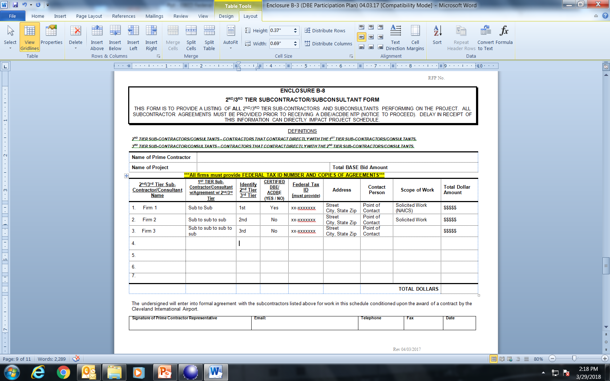
5d1. ENCLOSURE B-8
(ALL Tier Subcontractors/Sub-consultants)
RT/OCI FEDERAL PROGRAMS REQUIREMENTS UPDATED 01.12.2022
Notes:
26

Slide 27
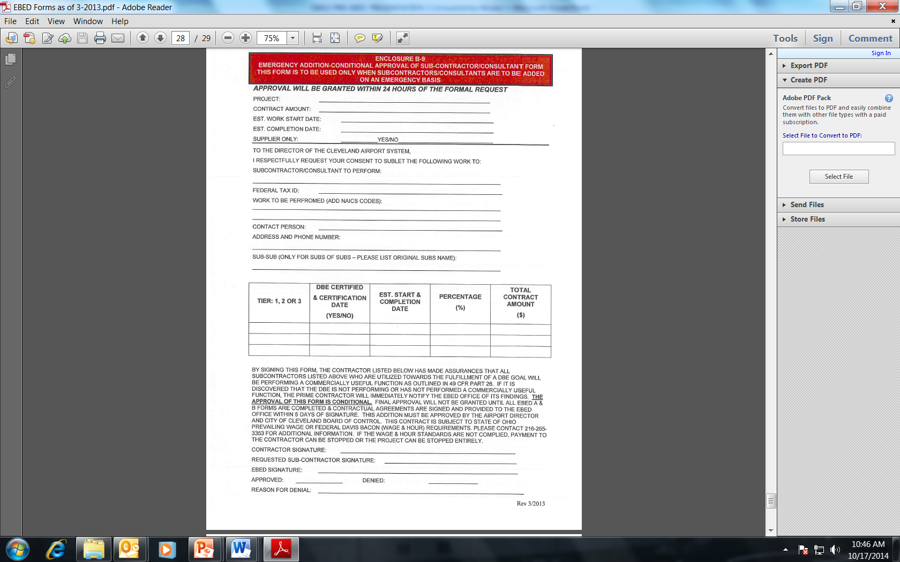
5e1. ENCLOSURE B-9
(EMERGENCY FORM)
Emergency Form Requirements:
Acquire prior approval before utilization of sub/s
Submit revised documents to add/exclude a sub
  For DBE – B-3, B-2, B-4A
  Non DBE – B6, B-4B
  For Tier – use forms accordingly
  3. Limited to 3 requests only
RT/OCI FEDERAL PROGRAMS REQUIREMENTS UPDATED 01.12.2022
Notes:
27

Slide 28
6. Project Compliance Requirements
  5a. Contract Clause Inclusion (29 CFR Part 5.13)
Assurance 49 CFR §26.13:
  “The contractor, sub recipient or subcontractor shall not discriminate on the basis of race, color, national origin, or sex in the performance of this contract. The contractor shall carry out applicable requirements of 49 CFR Part 26 in the award and administration of DOT assisted contracts. Failure by the contractor to carry out these requirements is a material breach of contract, which may result in the termination of this contract or such other remedy, as the recipient deems appropriate, which may include, but not limited to withholding monthly progress payments, assessing sanctions, liquidated damages, disqualifying the contractor from future bidding as non-responsible.”
Applied to ALL!
Prime Contractor, ALL Tier subcontracts/sub-agreements either certified and non certified DBE or SBE.
RT/OCI FEDERAL PROGRAMS REQUIREMENTS UPDATED 01.12.2022
Notes:
28

Slide 29
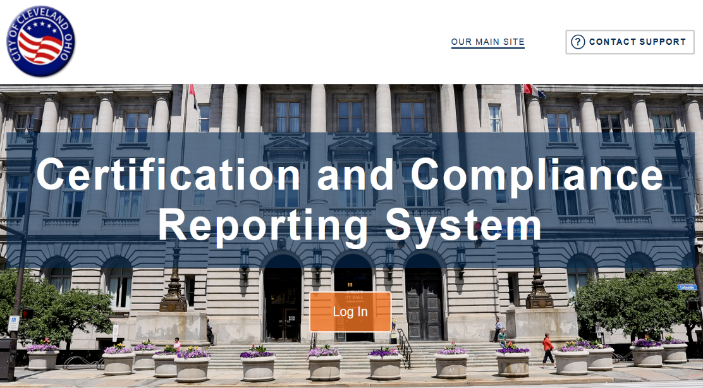
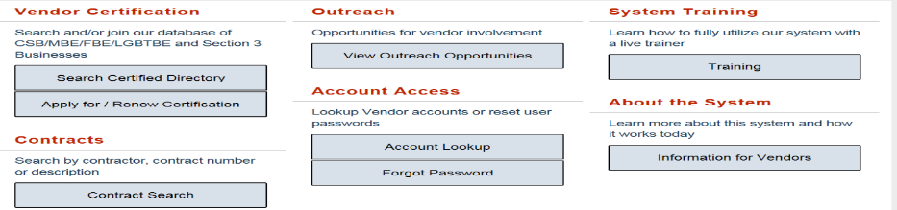
6. Project Compliance Requirements
6b. B2GNow Payments Compliance Reporting
What to do?
  Monthly Audit
  Subs Payment verifications
  Upload supporting documents (i.e. invoices and cancelled checks
Website: htpps://Cleveland.diversitycompliance.com/Default.asp)
Not sure what to do?
Training! Training! Training!
RT/OCI FEDERAL PROGRAMS REQUIREMENTS UPDATED 01.12.2022
Notes:
29

Slide 30
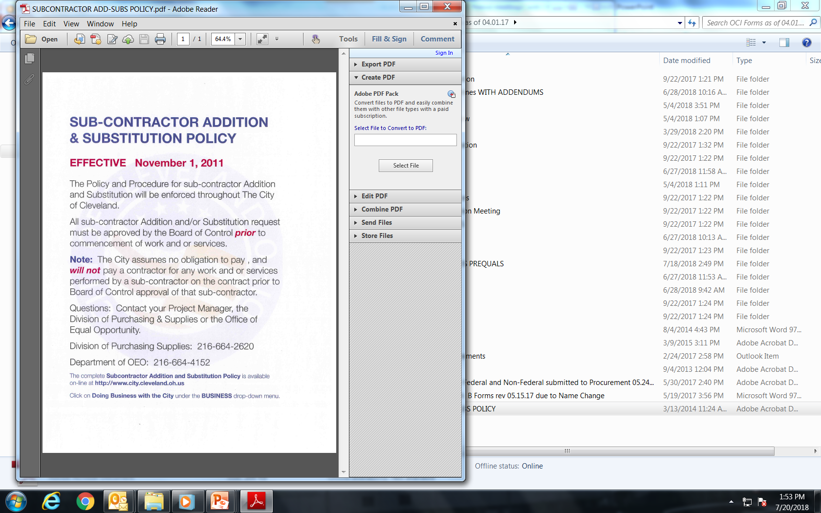
6d: Additions/Substitutions/exclusions of Subcontractors
49 CFR Part 26.53:
Require Prior approval
  Letter of justification from Prime
  Letter of approval from OCI
Good Faith Effort applied
City of Cleveland
AND…
Submit:
All corresponding forms
Sub-agreements
RT/OCI FEDERAL PROGRAMS REQUIREMENTS UPDATED 01.12.2022
Notes:
30

Slide 31
7. SANCTIONS FOR NON- COMPLIANCE
Regulation
http://www.dol.gov/whd/regs/compliance/whdfs66.pdf
Cancellation, termination or suspension of the contract
Contract payments withheld
Grounds for contract termination
Contractor liability for any resulting costs to the government
Debarment from future contracts for a period up to three years
OCI is providing ALL the information as a public service. This information and related materials are presented to give the public access to information on Department of Transportation and Department of Labor programs.
RT/OCI DAVIS BACON REQUIREMENTS UPDATED 01.12.2022

Slide 32
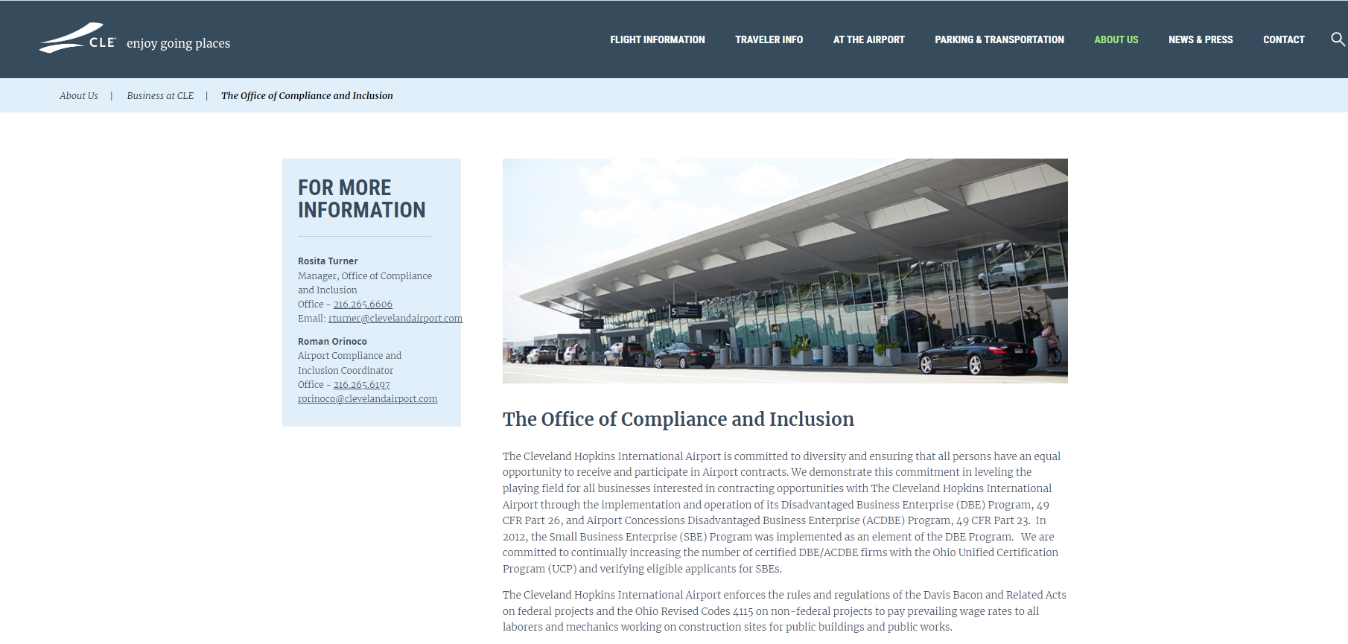
8. OCI WEBSSITE AND RESOURCES
RT/OCI FEDERAL PROGRAMS REQUIREMENTS UPDATED 01.12.2022
Notes:
32

Slide 33

OCI Requirements
Written questions - send to designated Procurement Officer
RT/OCI DAVIS BACON REQUIREMENTS UPDATED 01.12.2022

Slide 34
RFQ Schedule
Pre-Qualification meeting .......................................... November 3, 2023 @ 10:00 AM
Pre-Qualification meeting Addendum .............................. November 6, 2023
Deadline for Questions………………………….……………………November 15, 2023
(please submit via email to SMuia@clevelandairport.com)
Addendum (if necessary)……………………………………………November 20, 2023
Statement of Qualifications due ................... December 6, 2023 @ 4:00PM

Slide 35
Questions and Answers
Each Consultant shall submit seven (7) complete Statements, consisting of one (1) unbound original, five (5) identical bound copies and one (1) digital copy in either Microsoft Word (.doc/.docx) or Adobe Acrobat (.pdf) format
Firms may also elect to submit their Statements electronically. Please send the electronic Statements submission to airportprocurement@clevelandairport.com.
Please send all future questions to:
Department of Port Control
Environmental Services
5300 Riverside Drive
P.O. Box 81009
Cleveland, OH 44181-0009
Attention: Sharri Muia
Phone: (216) 265-2693
SMuia@clevelandairport.com

